Slide 1

Codebench : Evolution in Grading Platform
Advisor: Dr. Ananda Gunawardena

Slide 2
NB Grader and CodePost Integration

Slide 3
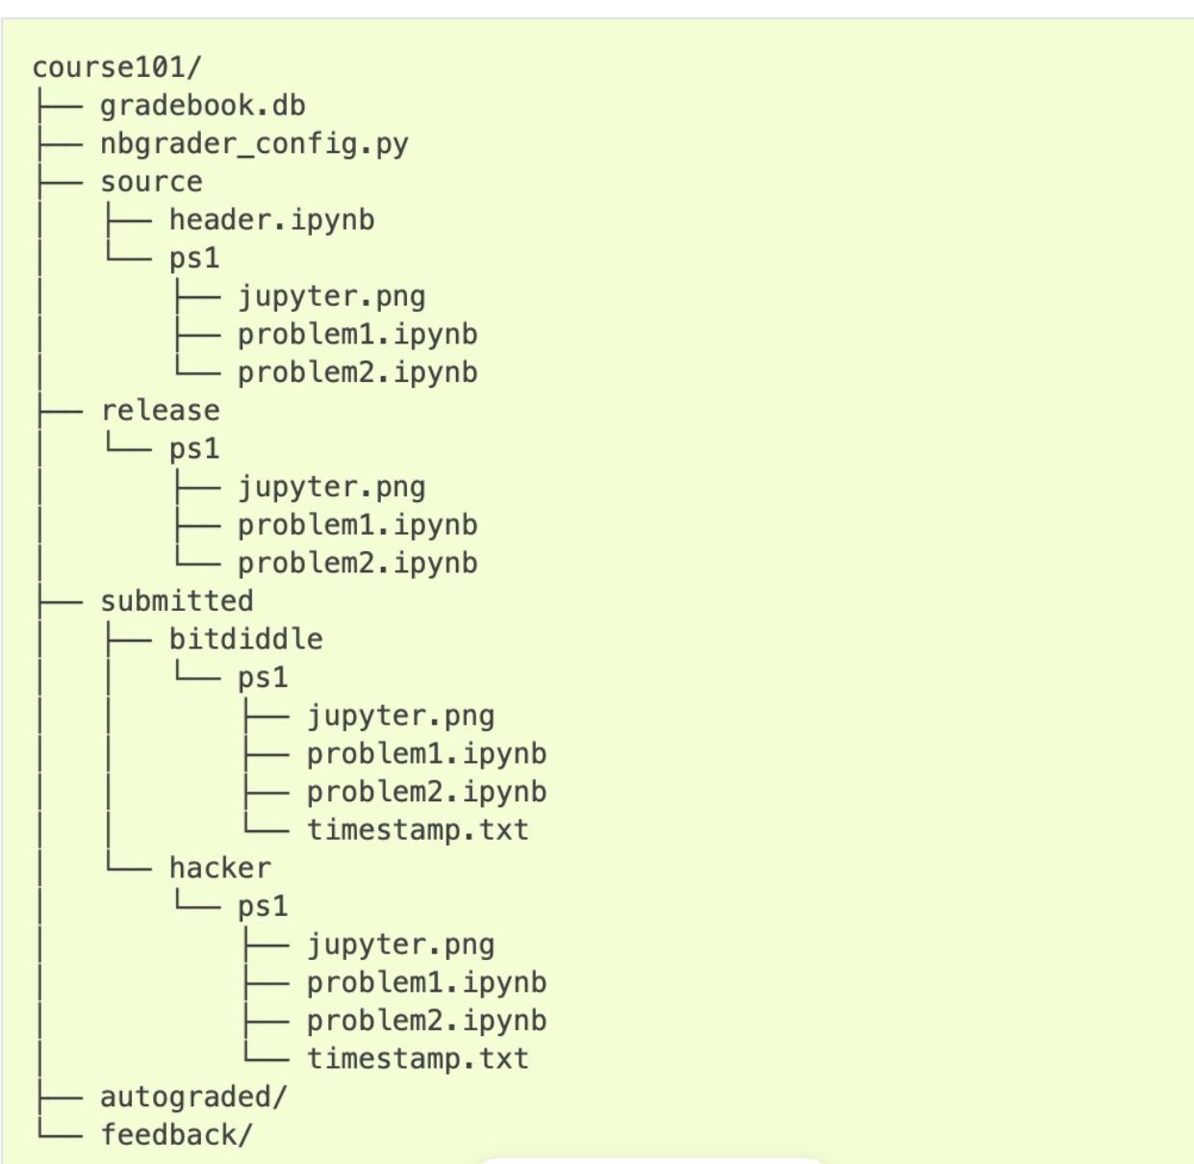
File Structure of NbGrader

Slide 4
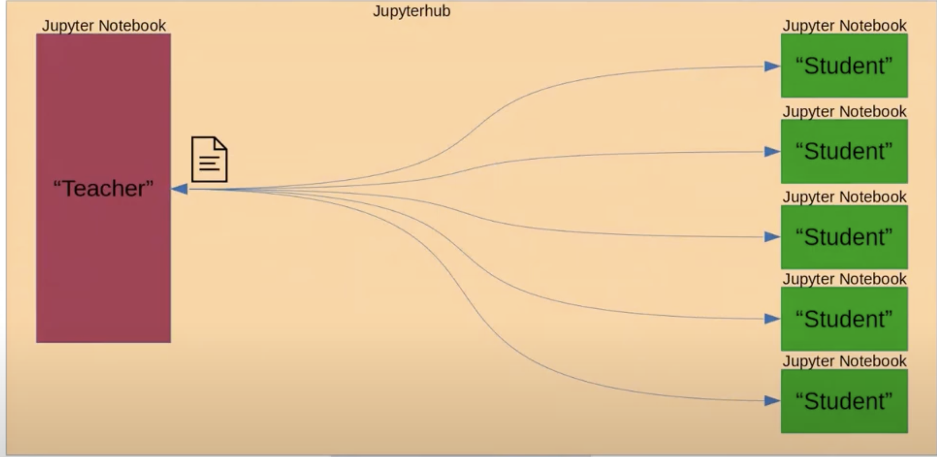
NbGrader and JupyterHub Integration

Slide 5
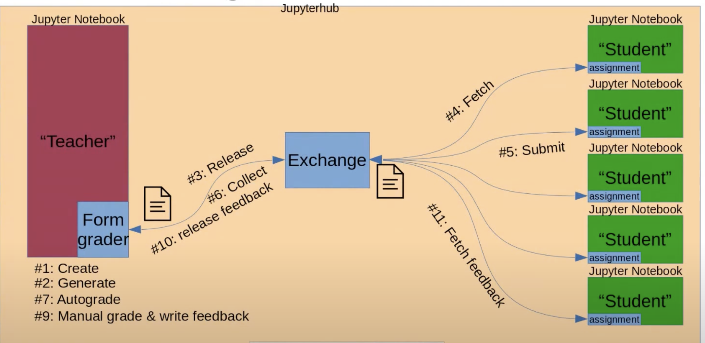
NbGrader WorkFLow

Slide 6
DrawBacks of NBGrader
1. Partnership in students
2. Multiple Graders
3. Cannot be used with JupyterLab

Slide 7
ELK Stack
Elastic Search
Logstash
Kibana

Slide 8

Elastic Search
Elasticsearch uses RESTful APIs to integrate with data ingestion tools like Logstash that send data to Elasticsearch in JSON document format
JSON documents are stored in Elasticsearch as an inverted index where every word that appears in every indexed document is mapped to the specific document(s) containing that word
This indexing pattern enables rapid text-based search and retrieval of log data in JSON format.

Slide 9

Logstash
.Logstash can pull from almost any data source using input plugins, apply a wide variety of data transformations and enhancements using filter plugins, and ship the data to a large number of destinations using output plugins.
It allows you to filter, massage, and shape your data so that it’s easier to work with.
It is responsible for aggregating data from different sources, processing it, and sending it down the pipeline, usually to be directly indexed in Elasticsearch

Slide 10

Kibana
Kibana’s core feature is data querying and analysis. Using various methods, users can search the data indexed in Elasticsearch for specific events or strings within their data for root cause analysis and diagnostics.
Based on these queries, users can use Kibana’s visualization features which allow users to visualize data in a variety of different ways, using charts, tables, geographical maps and other types of visualizations.

Slide 11
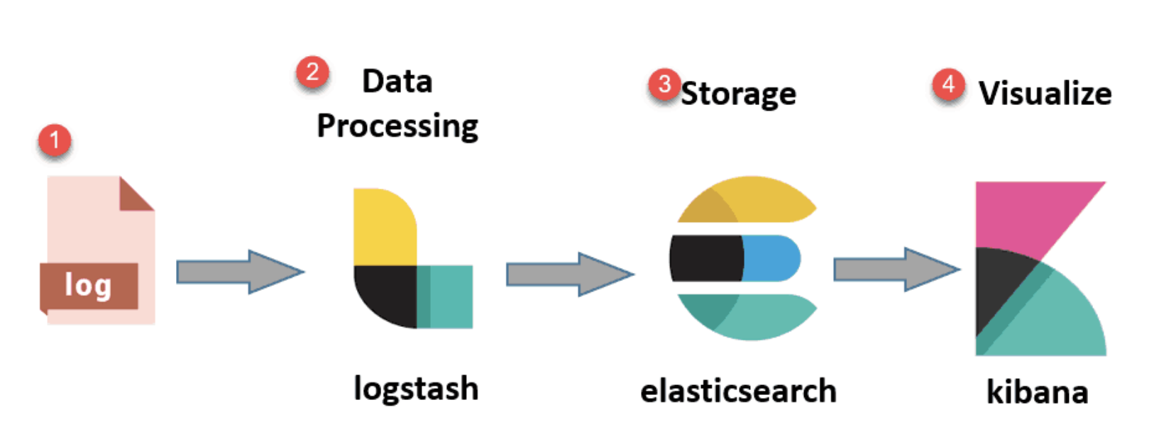
Workflow

Slide 12

COnclusion
Platform issues decreased with time as the number of contact us inquiries during the month of December was incredibly low.
The most often used tab in the entire application was "Jupyterlab," which was followed by "Jupyterlab and Codepost," indicating that users prefer to work in full screen rather than split screen when completing assignments.
It has been shown that students were most engaged in the first three days and the five days before to the assignment due.
We integrated jupyterlab logs into the ELK stack and discovered that the field status code in the elasticsearch database, which can be filtered using Kibana, has 571 hits with the 404 status code, which is a bad request error since students were unable to log into jupyterhub.

Slide 13

Thank you
Anmol – as3593

